Slide 1
pcpfm: A Python-centric pipeline for high-fidelity and high-performance LC-MS metabolomics data processing.
Joshua Mitchell M.D./Ph.D.
Data Scientist
Shuzhao Li Group
The Jackson Laboratory for Genomic Medicine
Notes:
Mention annotation of feature tables. Maybe show example.

Slide 2
Outline
Part 1 – Asari
Asari standalone usage and feature table generation
Part 2 – Basic Pipeline Usage
Running asari with the pcpfm
Part 3 – Advanced Pipeline Usage
Annotating asari results with MS2 using the pcpfm
All materials are also available online in the github repo

Slide 3
Preparation
You will need python3 installed (this depends on your operating system)
Install asari and the pipeline
`pip3 install asari-metabolomics`
`pip3 install pcpfm`
Download the example dataset:
URL
Notes:
Another notable distinction is the technologies used for studying these entities. On the left, sequencing of one form or another is used to analyze these samples. Chemical space on the other hand is measured primarily using mass spectrometry-based techniques.

Slide 4
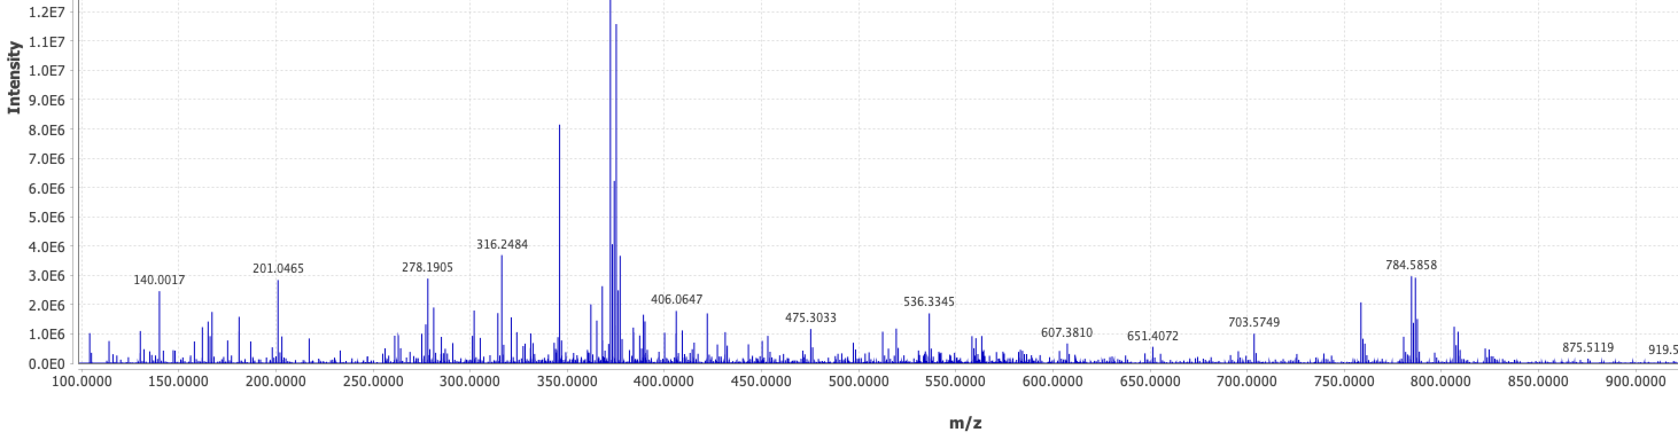
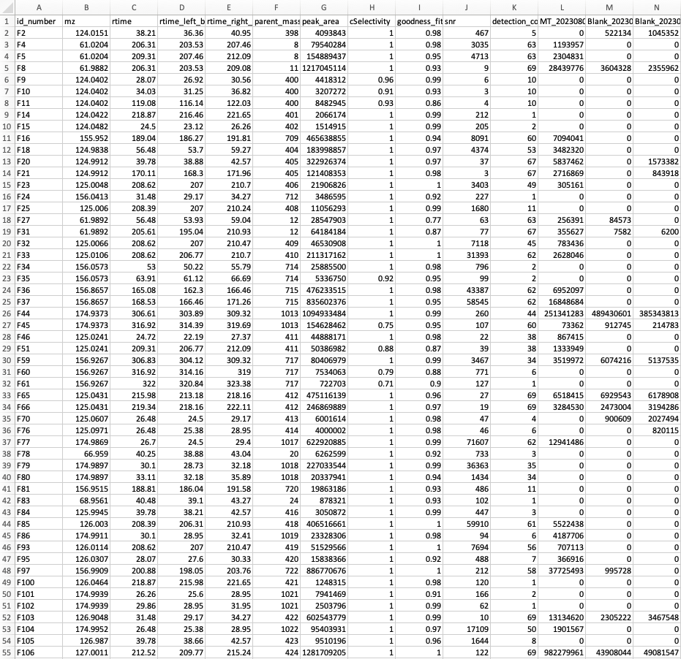
Asari Performs LC-MS Pre-Processing
Sample 1
Sample 2
Feature Table
Pre-Processing
Sample 3
Sample 4
…
Goals:
Identify features in acquisitions
Provide an estimate of that feature’s abundance per sample
Challenges:
Computationally expensive
Cross-sample feature correspondence
Feature quality
Notes:
Another notable distinction is the technologies used for studying these entities. On the left, sequencing of one form or another is used to analyze these samples. Chemical space on the other hand is measured primarily using mass spectrometry-based techniques.

Slide 5
Reproducibility issues in LC-MS metabolomics data processing
XCMS 10,901
features
MZmine
42,099 features
6,186
Li et al., (2023) Nature Communications, 14(1), 4113.
Myers et al. (2017). Analytical Chemistry, 89(17): 8689
Delabriere et al., (2021). Analytical Chemistry, 93(45):15024
Notes:
Another notable distinction is the technologies used for studying these entities. On the left, sequencing of one form or another is used to analyze these samples. Chemical space on the other hand is measured primarily using mass spectrometry-based techniques.

Slide 6
Top Four Reasons for Poor Reproducibility
High rate of correspondence errors in large data
Spurious number of low-quality peaks, confusion of sensitivity
Peak detection not transparent enough
Too many parameters, too dependent on local expertise
Notes:
Another notable distinction is the technologies used for studying these entities. On the left, sequencing of one form or another is used to analyze these samples. Chemical space on the other hand is measured primarily using mass spectrometry-based techniques.

Slide 7
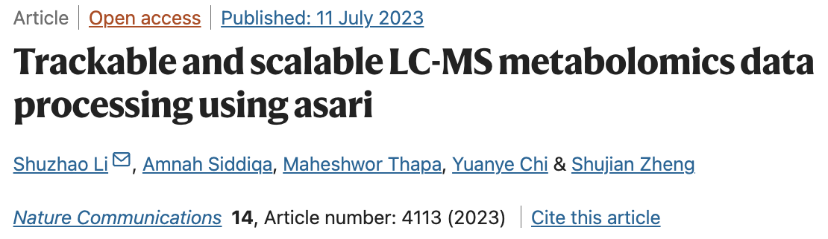
Detailed account of technical issues
Trackable data structure at every level in asari
New algorithms, new build
A useful set of quality control metrics
Performant, easy to deploy, easy to scale

Slide 8
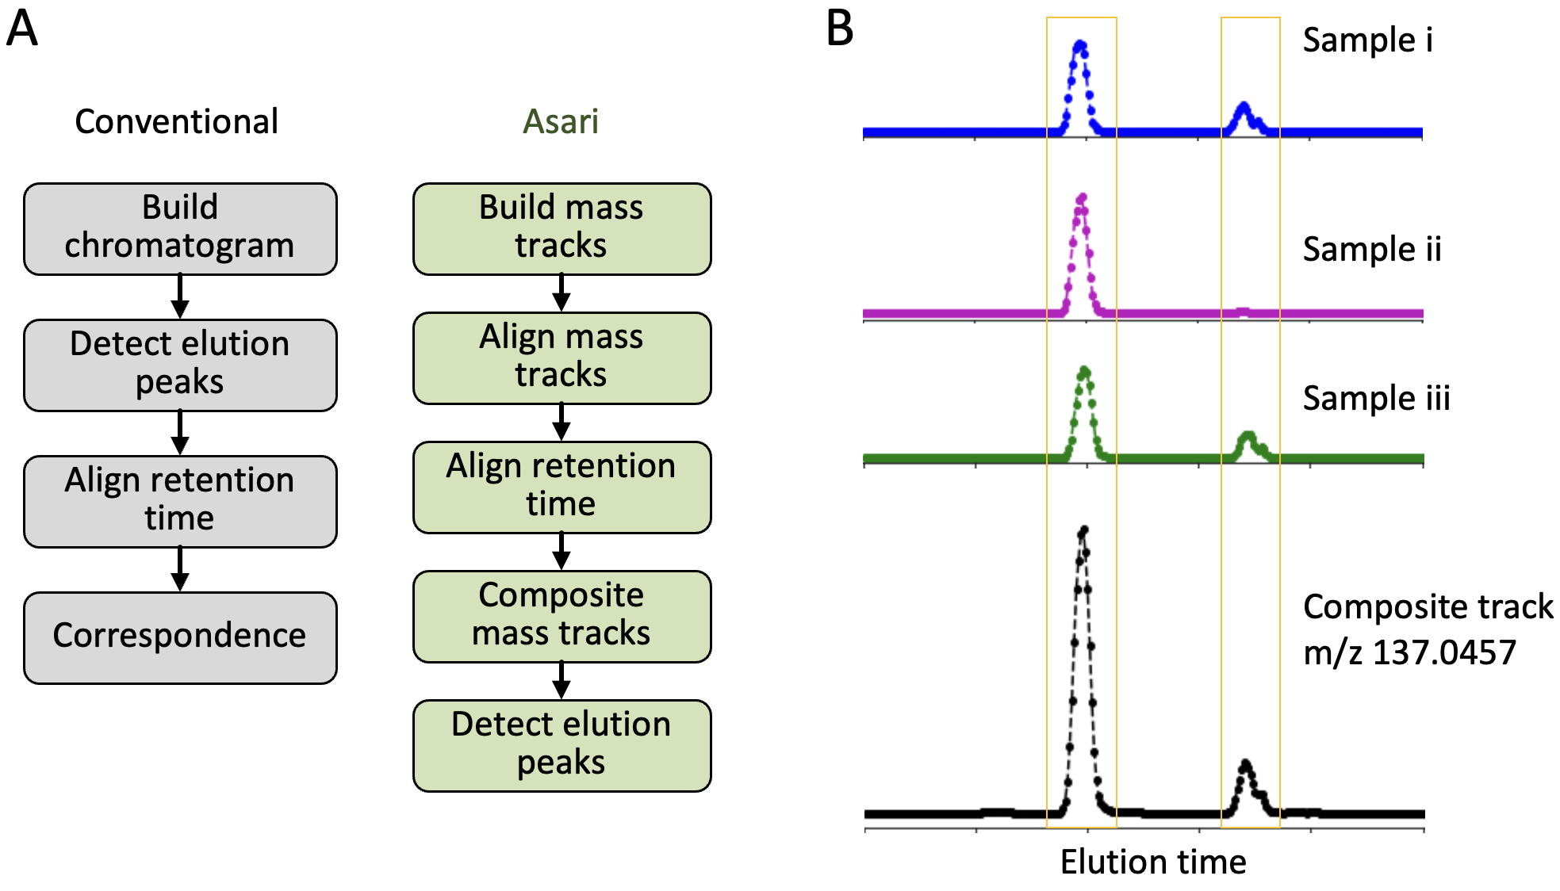
Asari vs. Conventional

Slide 9
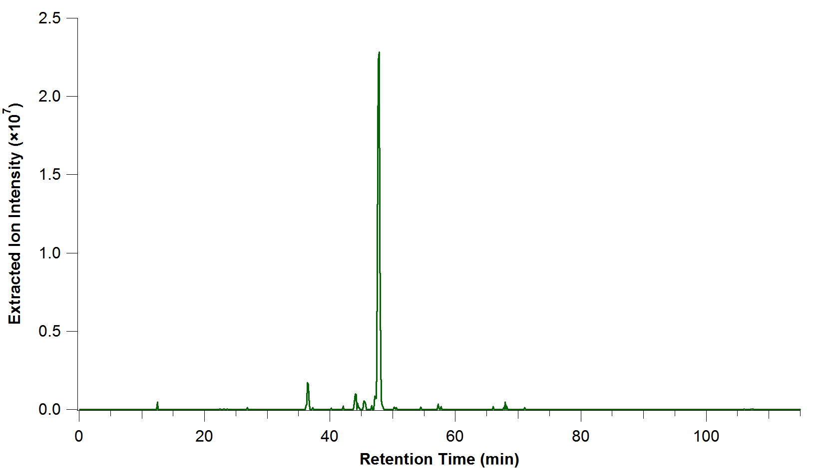
Asari vs. Conventional
XICs
Peak Detect
rt
m/z
By CWenger at English Wikipedia, CC BY-SA 3.0, https://commons.wikimedia.org/w/index.php?curid=70844603

Slide 10
Asari vs. Conventional
XICs
Alignment
Peak Detect
rt
rt
m/z
m/z
By CWenger at English Wikipedia, CC BY-SA 3.0, https://commons.wikimedia.org/w/index.php?curid=70844603

Slide 11
Asari vs. Conventional
XICs
Alignment
rt
Peak Detect
rt
m/z
rt
m/z
m/z
By CWenger at English Wikipedia, CC BY-SA 3.0, https://commons.wikimedia.org/w/index.php?curid=70844603

Slide 12
Asari vs. Conventional
XICs
Replace w/ XIC
Alignment
rt
Peak Detect
rt
m/z
rt
m/z
rt
Failed correspondence
m/z
m/z
Peak picking then alignment makes alignment more difficult (2d alignment).
Fails to fully leverage the high m/z resolution of modern LC-MS instruments
By CWenger at English Wikipedia, CC BY-SA 3.0, https://commons.wikimedia.org/w/index.php?curid=70844603

Slide 13
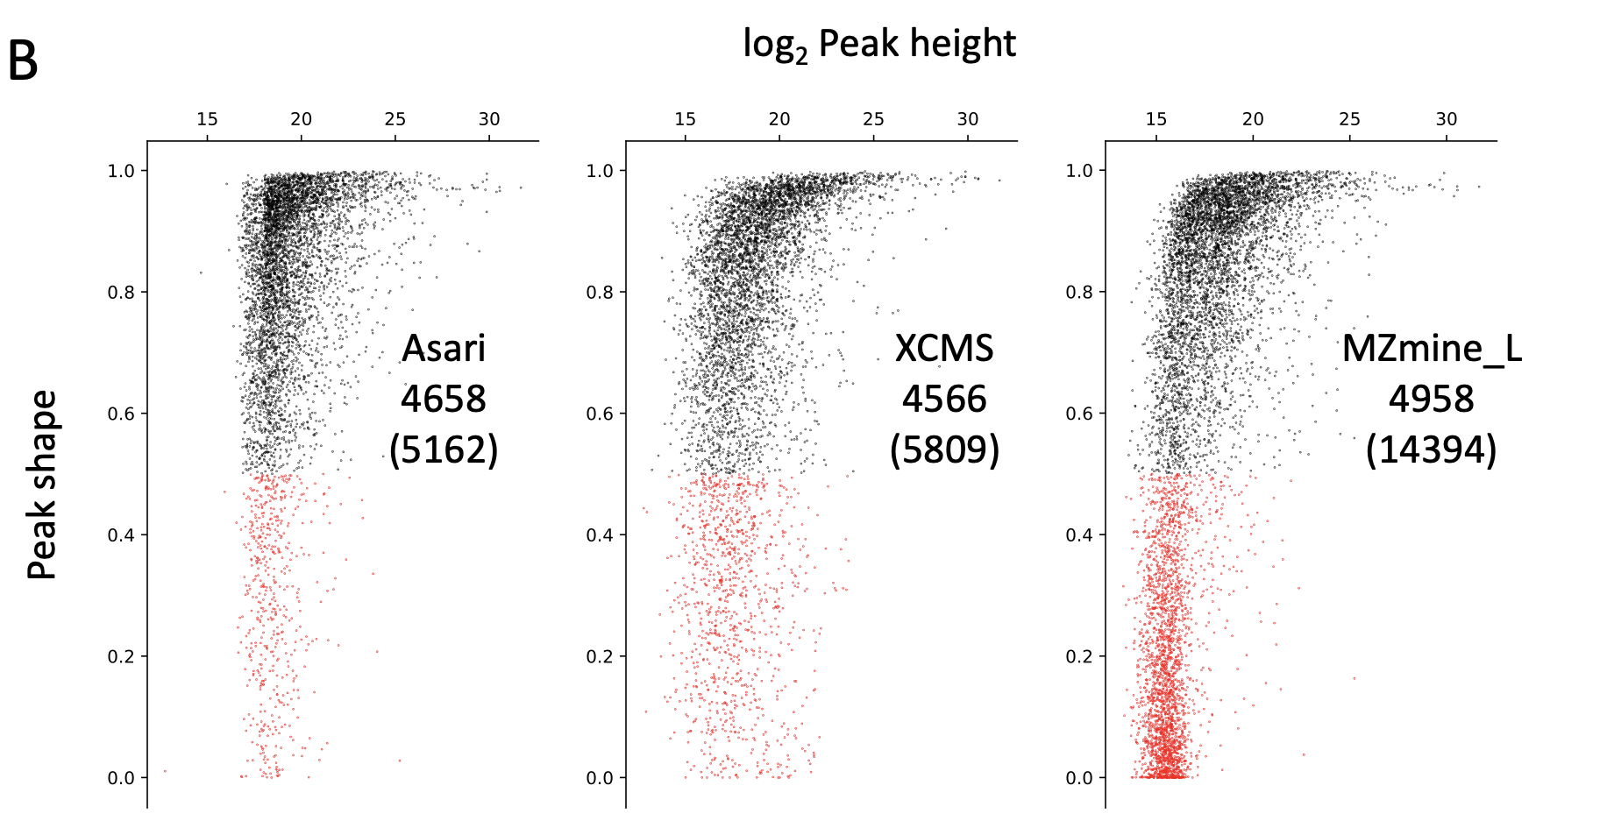
Elution Peak Detection Yields Low-Quality Features
Log Peak Height
Goodness of Peak Shape
Many features but many are low quality.
Similar numbers of high-quality features.

Slide 14
Correspondence Issues and Mass Selectivity
MZmine
XCMS
m/z | rtime | m/z | rtime
760.5857 | 73 | 760.5807 | 68
760.5833 | 73 | 760.5817 | 72
760.5815 | 67 | 760.5826 | 72
 |  | 760.5837 | 72
 |  | 760.5847 | 73
Falsely resolved isobaric features due to poor correspondence
XCMS
MZmine
Asari
Kernel Density
Mass Selectivity

Slide 15
Asari Pre-Processing vs. Conventional

Slide 16
Asari Pre-Processing vs. Conventional
Mass tracks are XICs spanning all retention time

Slide 17
Asari Pre-Processing vs. Conventional
Mass tracks are XICs spanning all retention time

Slide 18
Asari Pre-Processing vs. Conventional
Mass tracks are XICs spanning all retention time
Notes:
Errors in mass alignment not sole reason for poor performance.

Slide 19
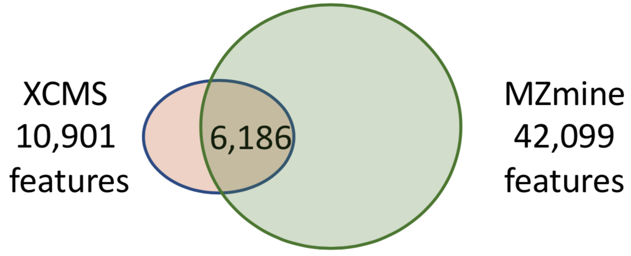
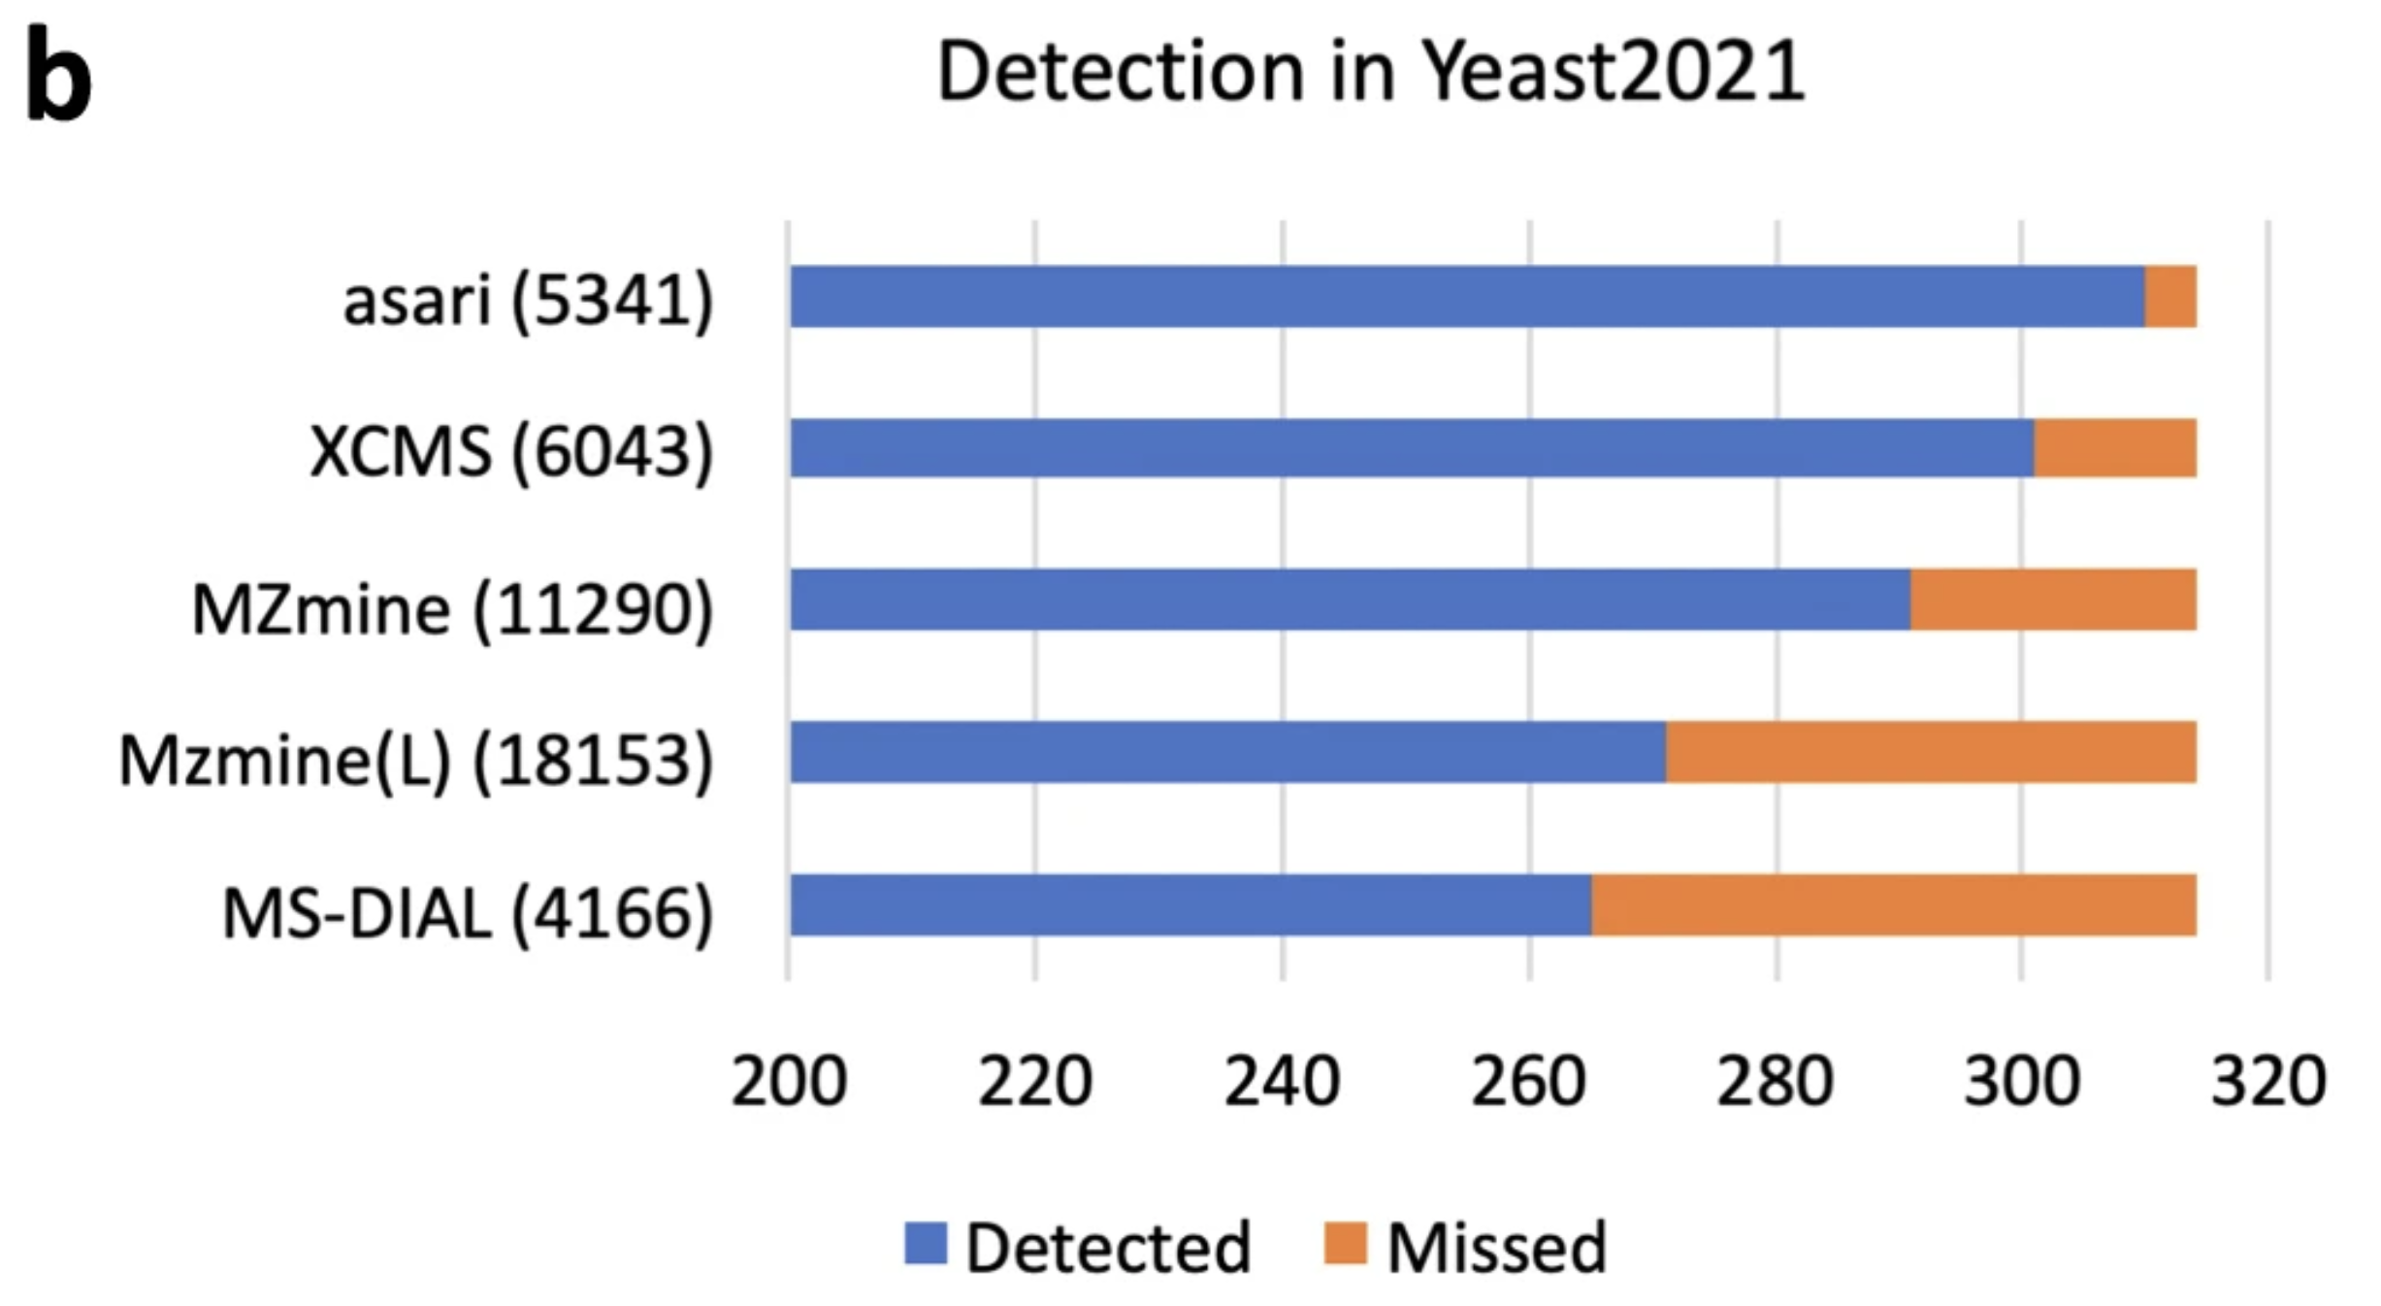
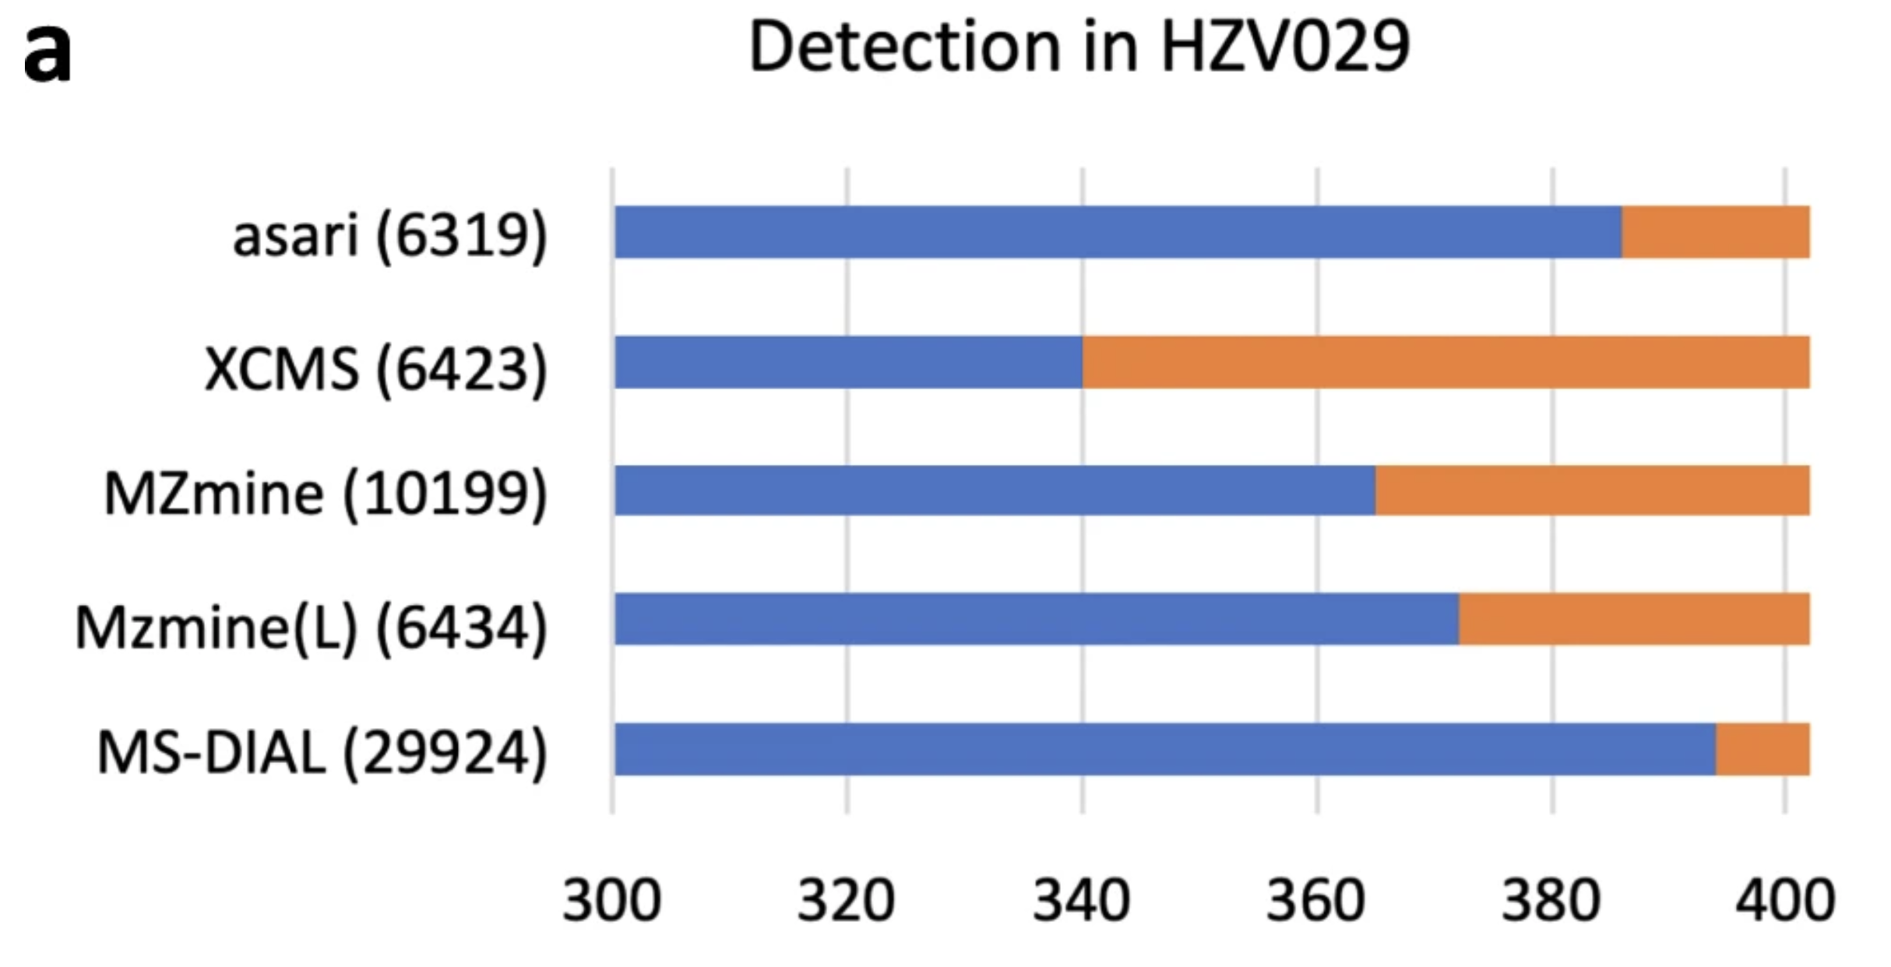
Consistent Feature Detection with Asari
Features from 184 Pooled QC Samples
Asari Reference Here

Slide 20
Asari Generates High Quality Features
Log Peak Height
Goodness of Peak Shape
Normally not detected. These features were included to enable comparison between tools

Slide 21
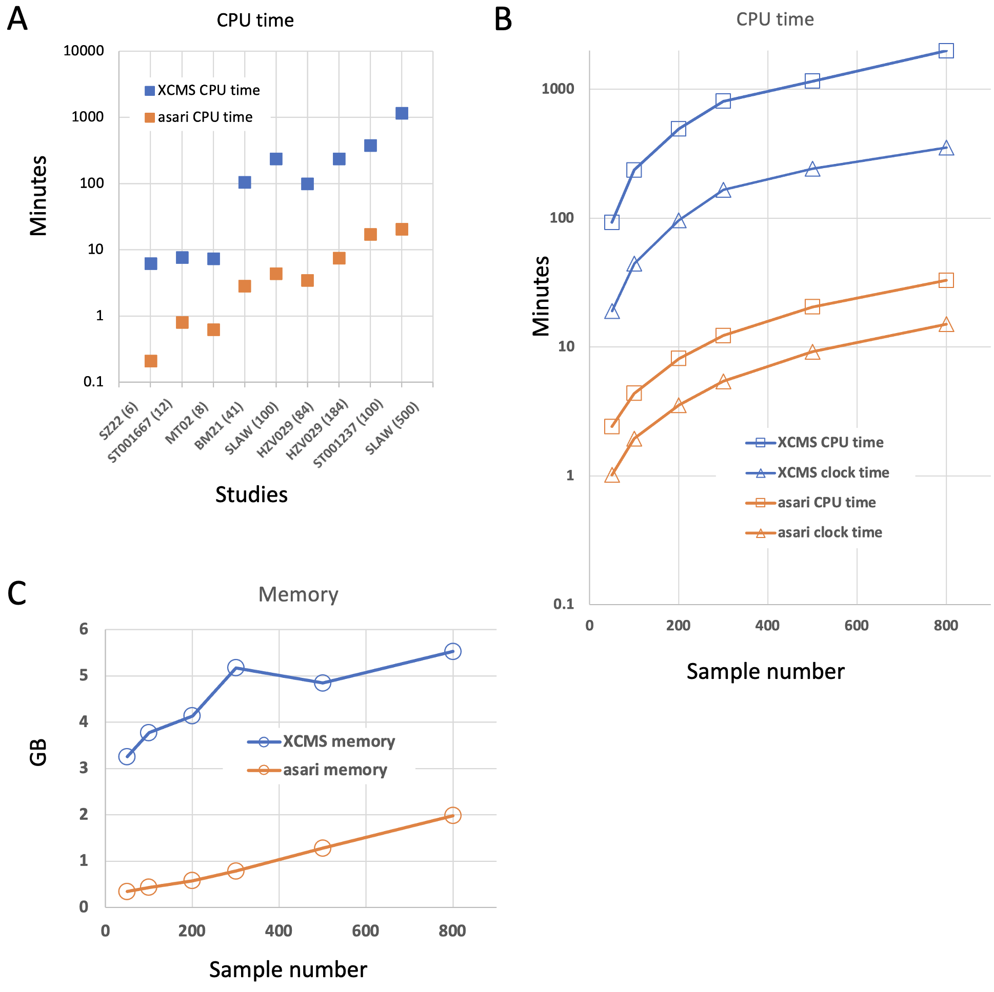
Asari Offers Greatly Improved Performance

Slide 22
Asari Hands-On

Slide 23
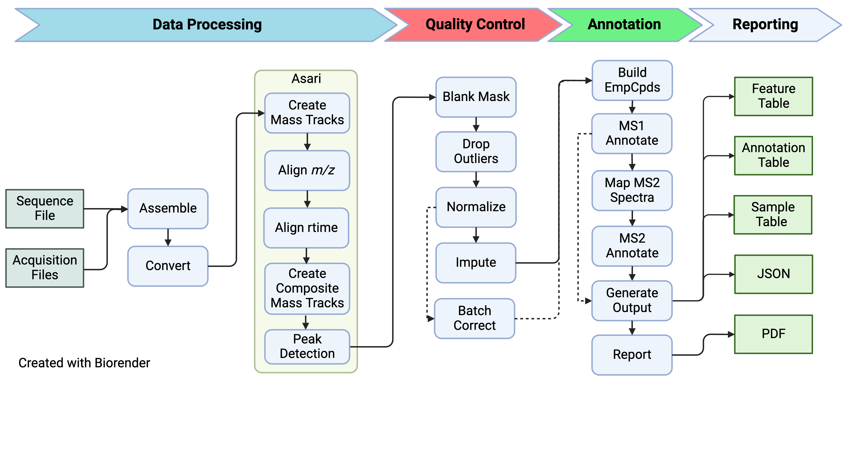
Using the pcpfm version of Asari
Asari is integrated into the pcpfm pipeline.
When using asari in the pipeline, having a metadata csv file is recommended.
Notes:
More details: spikein, PCA, correlation, etc. (can be talking points)

Slide 24
Basic pcpfm Hands-On

Slide 25
What’s Next After Asari?
Will focus on Annotation but QA/QC is important too
Notes:
More details: spikein, PCA, correlation, etc. (can be talking points)

Slide 26
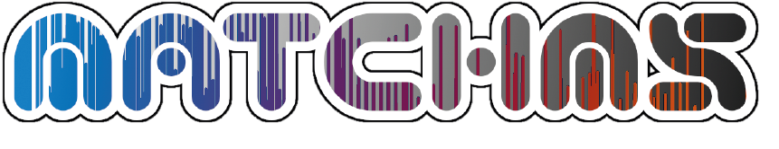
Annotation Concepts
Annotation is the mapping of features to metabolites with varying degrees of confidence:
Level 1: retention time and m/z similarity to authentic standards, ideally with MS2
Level 2: MS2 similarity to database spectra
Level 4: m/z similarity to database entries
Pre-Annotation: assign isotopologue and adduct to features, group features belonging to same compound
Decreasing
Confidence
Ion mobility, collision cross-section, biological context, etc. can improve annotation but not included in the pipeline.
Li and Zheng, 2023. Analytical Chemistry
MS/MS search by MatchMS, accelerated with IntervalTrees

Slide 27
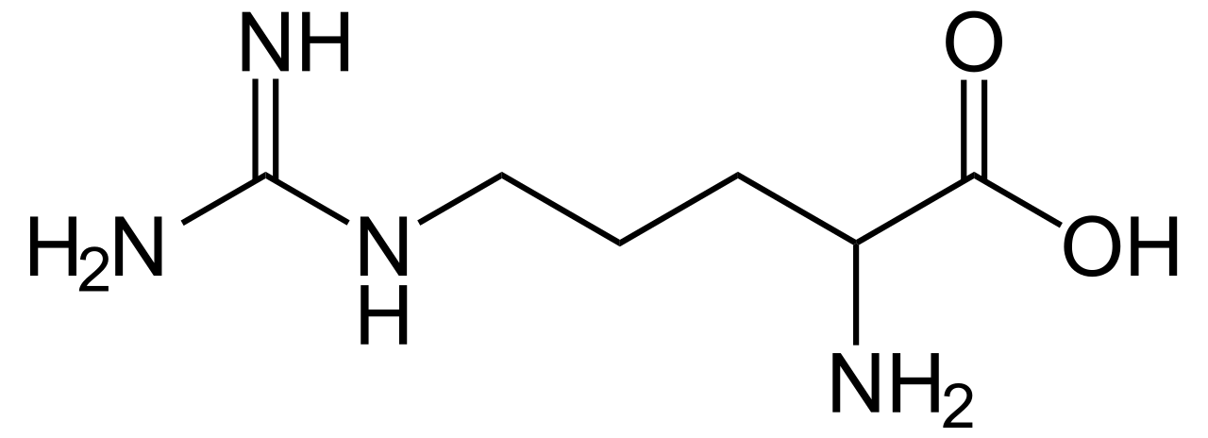
What is Pre-Annotation?
Traditional techniques, each feature is queried for annotation = 6 searches! More false positives
One Compound, Many Features
m, +H⁺
m, +Na⁺
m+¹³C₁, +H⁺
m, +ACN⁺
m+¹³C₂, +H⁺
m+¹³C₁, +Na⁺
m/z
Empirical Compound
Empirical compound means one query and fewer false positives.
Inferred Neutral Mass
Notes:
mzunit, CAMERA, binner perform a similar ‘pre-annotation’ but khipu performs the regression that allows for the inference of mass and yields a computable data structure.

Slide 28


Implementation
Pre-Annotation is performed using Khipu
MS² operations use MatchMS
pandas and numpy used for data wrangling and QA/QC
All packaged into one python package: ‘pcpfm’
Li and Zheng, 2023. Analytical Chemistry
Huber et al., 2020. JOSS
McKinney 2010
Harris et al., 2020. Nature
Matchms – processing and similarity evaluation of mass spectrometry data. (2020) Journal of Open Source Software, 5(52), 2411. https://doi.org/10.21105/joss.02411
Matchms – processing and similarity evaluation of mass spectrometry data. (2020) Journal of Open Source Software, 5(52), 2411. https://doi.org/10.21105/joss.02411
Notes:
mzunit, CAMERA, binner perform a similar ‘pre-annotation’ but khipu performs the regression that allows for the inference of mass and yields a computable data structure.

Slide 29
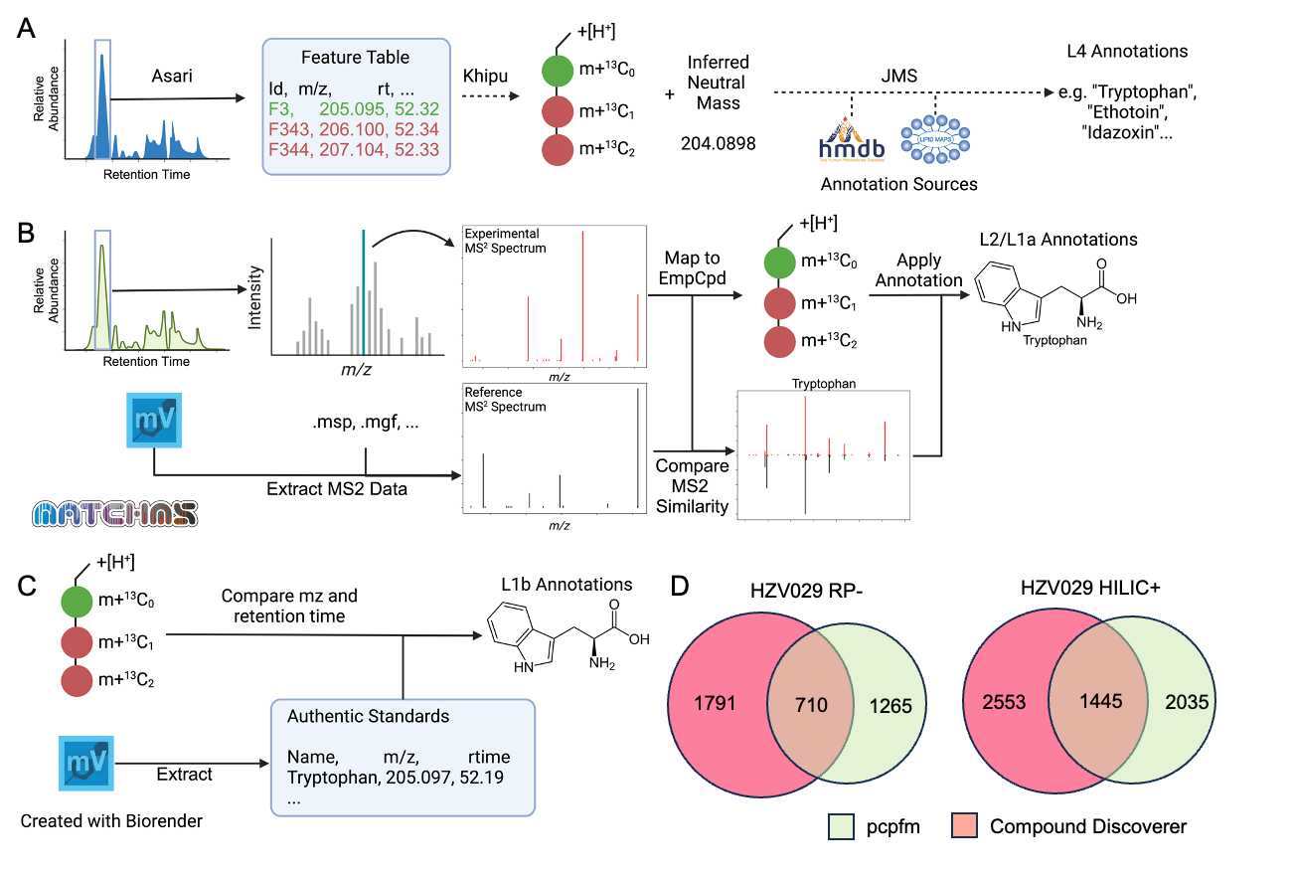
Annotation Levels
Level 4

Slide 30
Annotation Levels
Level 4
Level 2/1

Slide 31
Annotation Levels
Level 4
Level 2/1
Level 1

Slide 32
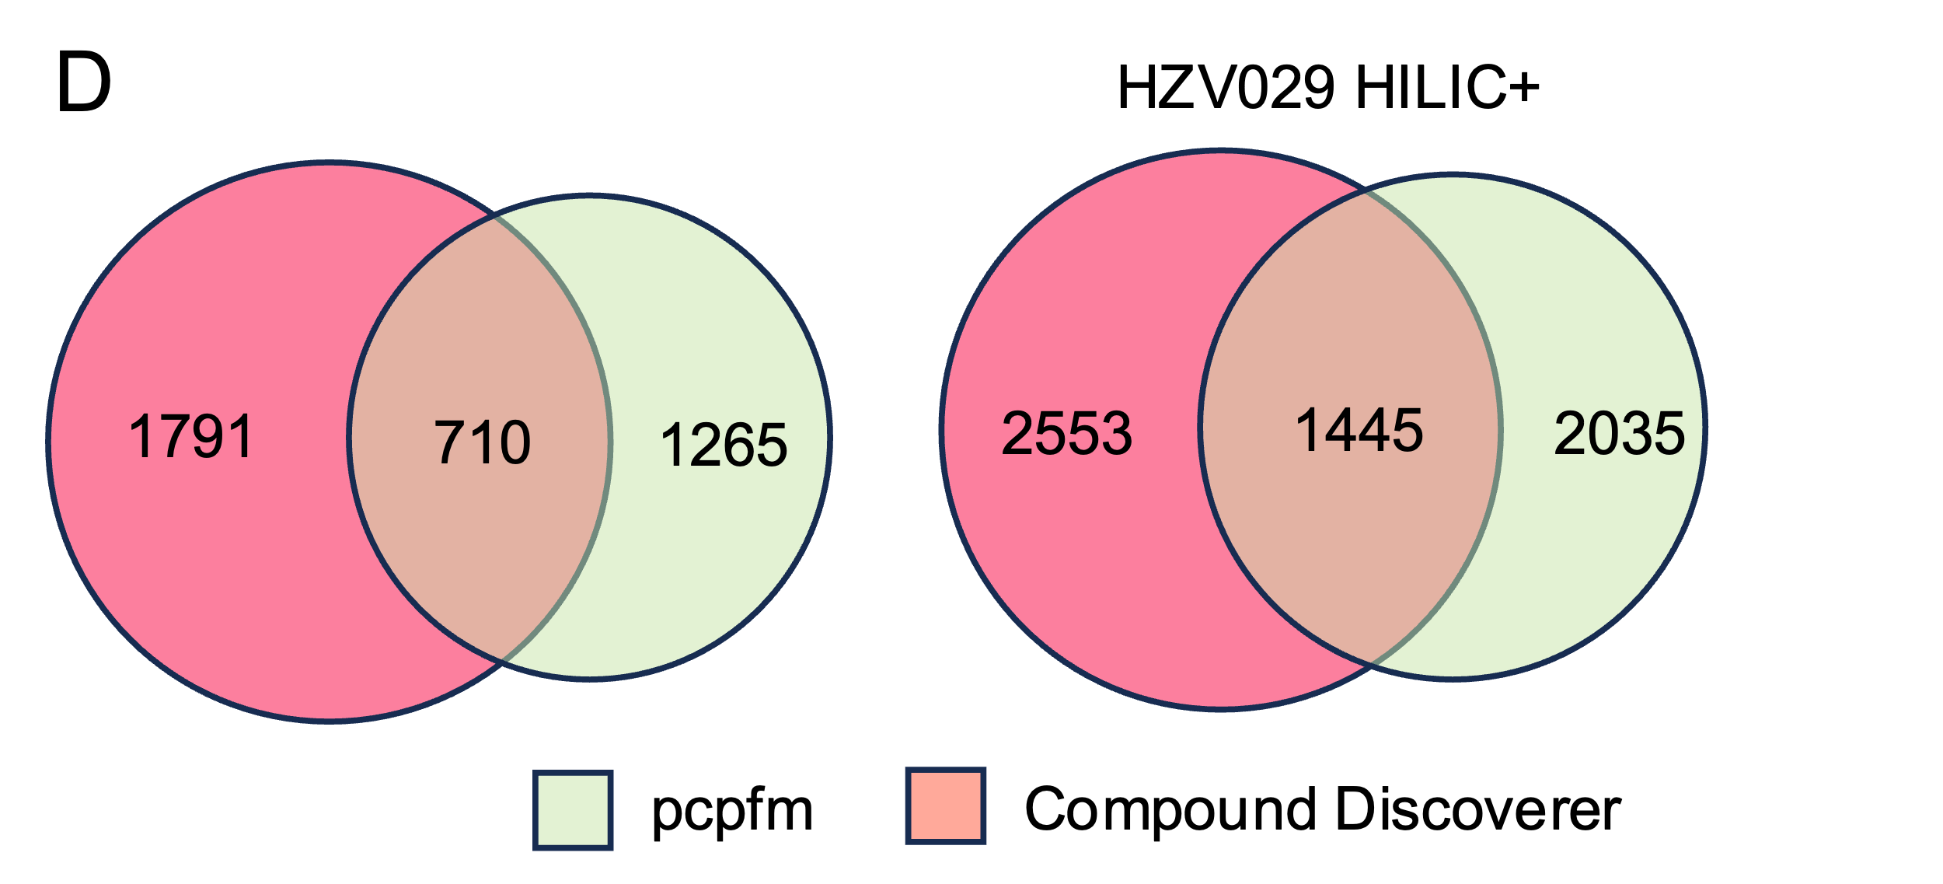
Annotation Levels
Level 4
Level 2/1
Level 1

Slide 33
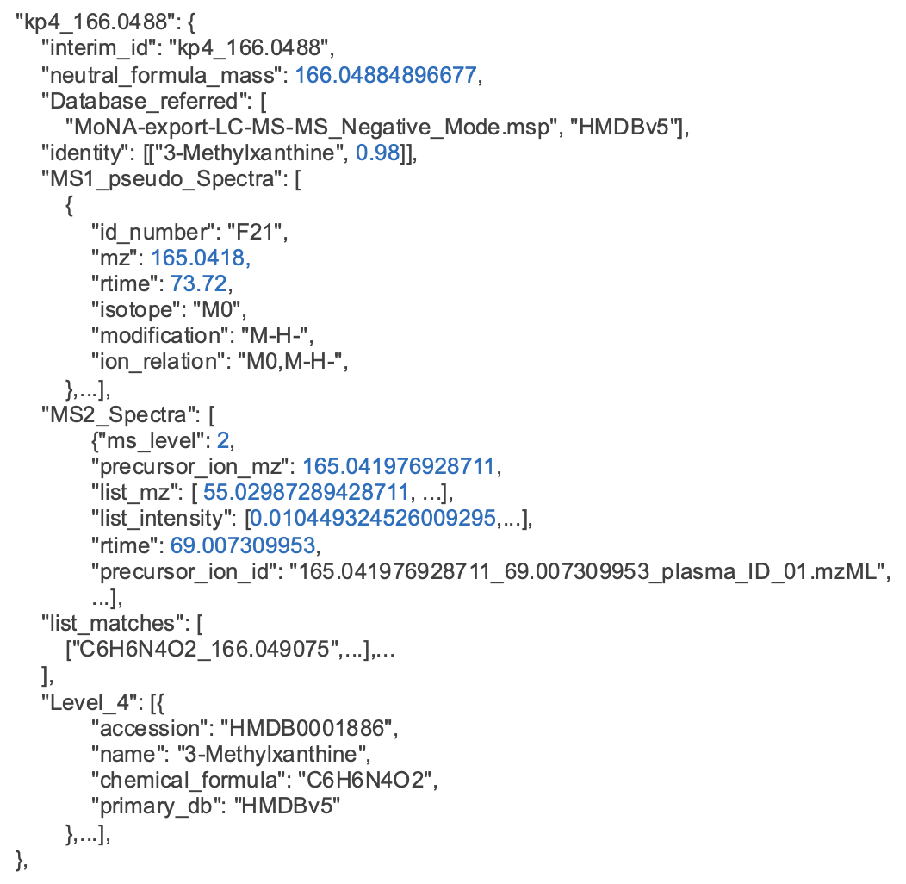
Chainable Annotations via Empirical Compounds
Notes:
Not searching all features against all entries.
Schmansky

Slide 34
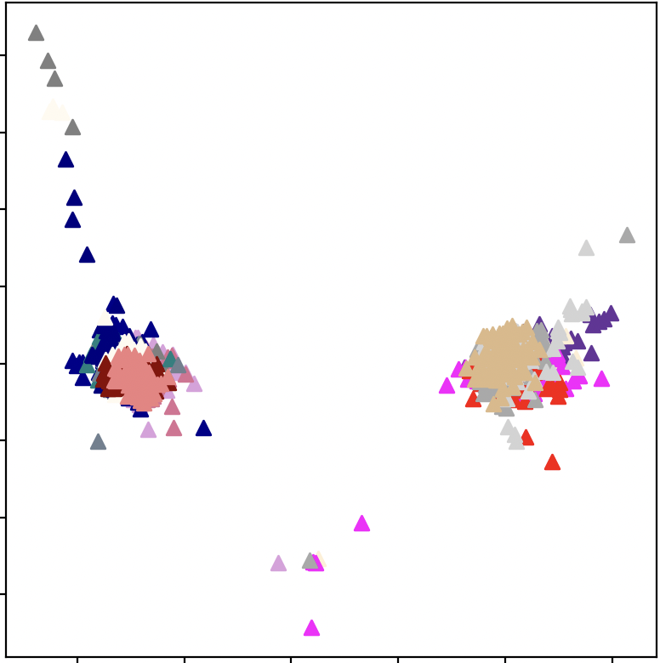
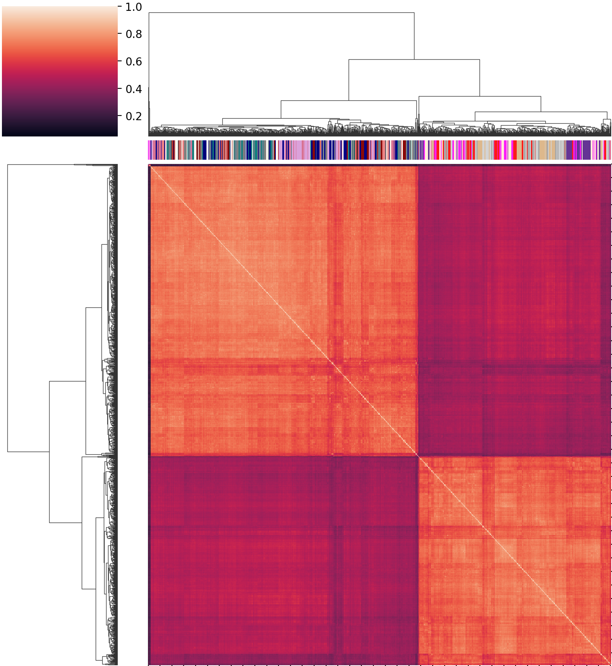
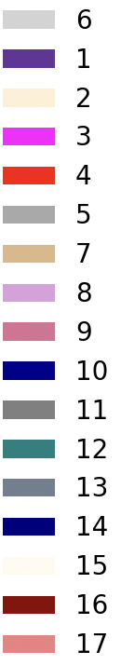
Chainable Annotations via Empirical Compounds
Batch 1
Batch 2
Batch 3
Batch 4
Batch 5
Batch 6 Batch 7
Batch 8
Batch 9
Batch 10
Batch 11
Batch 12
Batch 13
Batch 14
Batch 15
Batch 16
Batch 17
PC2 - 2.1%
Calibration
Group 1
Group 2
PC1 – 6.4%
~1700 samples over 17 batches
Raw Data
Notes:
Batch on top, not repeat.,

Slide 35
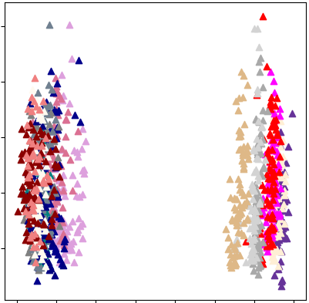
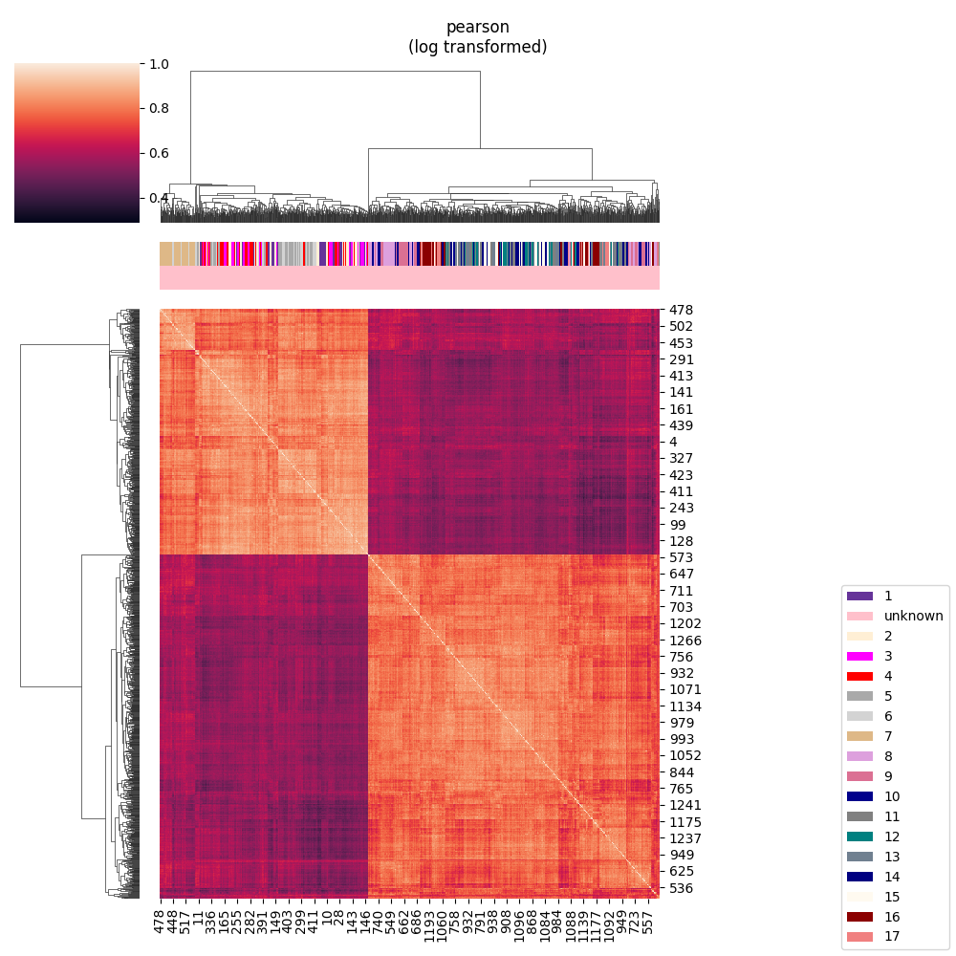
Chainable Annotations via Empirical Compounds
Batch 1
Batch 2
Batch 3
Batch 4
Batch 5
Batch 6 Batch 7
Batch 8
Batch 9
Batch 10
Batch 11
Batch 12
Batch 13
Batch 14
Batch 15
Batch 16
Batch 17
Calibration
PC2 – 10.8%
Calibration
PC1 – 6.4%
PC2 – 28.5%
Normalized, Imputed

Slide 36
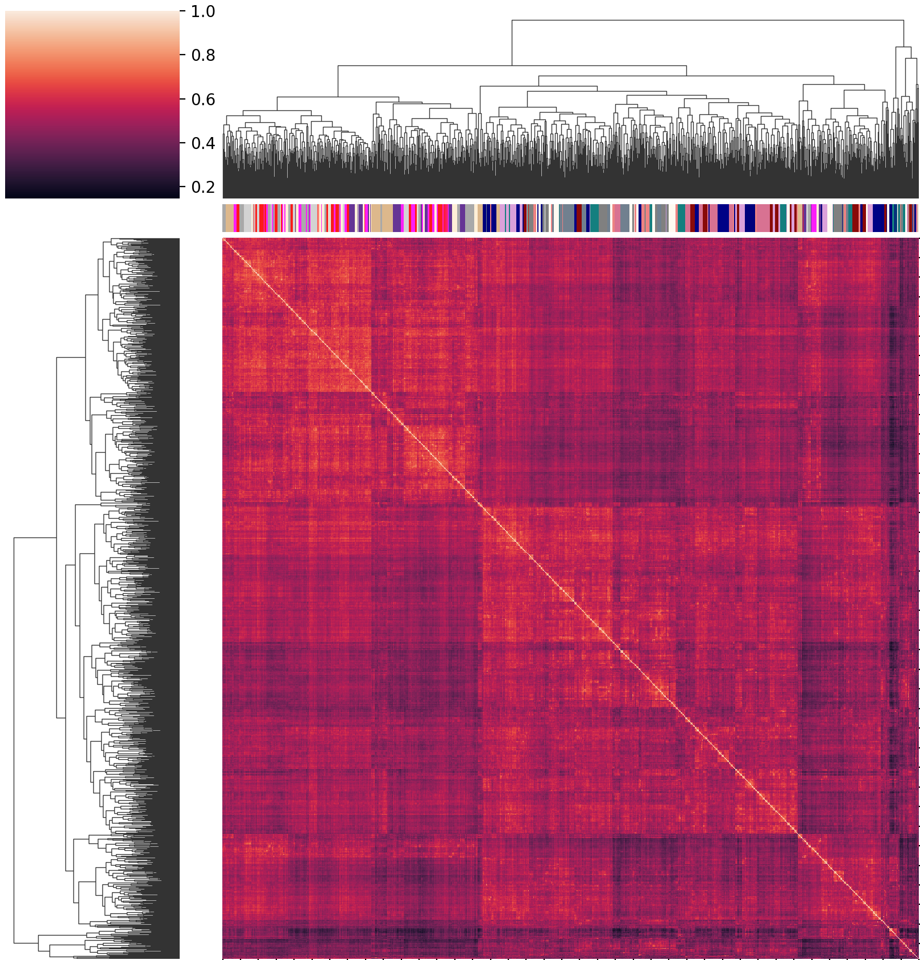
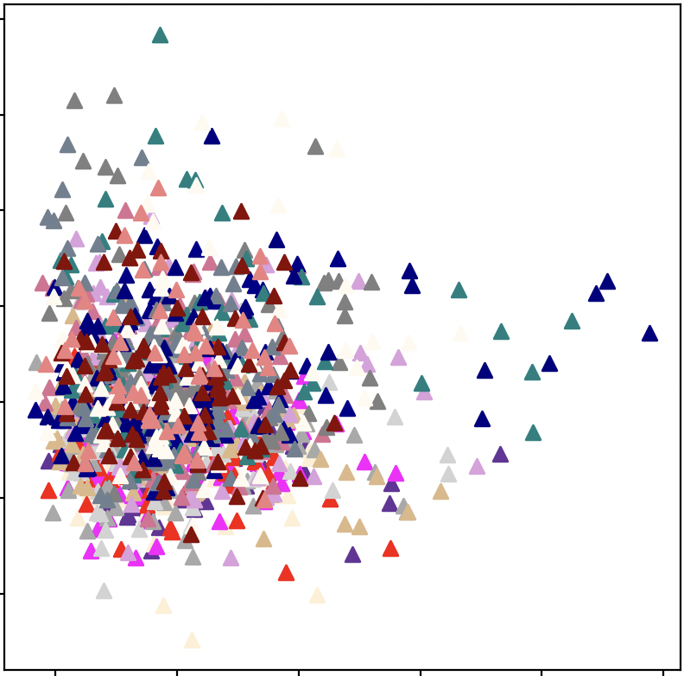
Chainable Annotations via Empirical Compounds
Batch 1
Batch 2
Batch 3
Batch 4
Batch 5
Batch 6 Batch 7
Batch 8
Batch 9
Batch 10
Batch 11
Batch 12
Batch 13
Batch 14
Batch 15
Batch 16
Batch 17
Calibration
Calibration
PC2 – 3.1%
PC1 – 9.8%
Batch Corrected

Slide 37
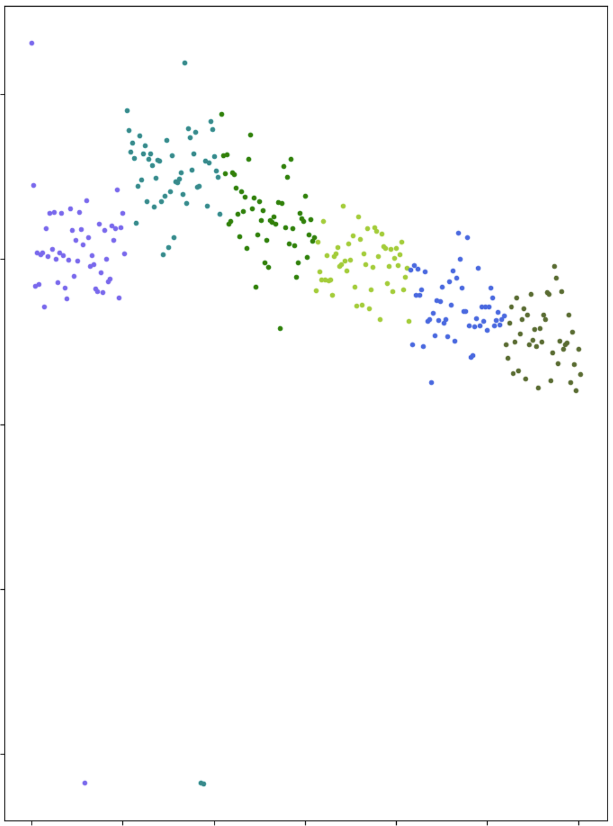
Outlier Detection
2
# Features Z-Score
0
-6
Failed Injections
Sample Number

Slide 38
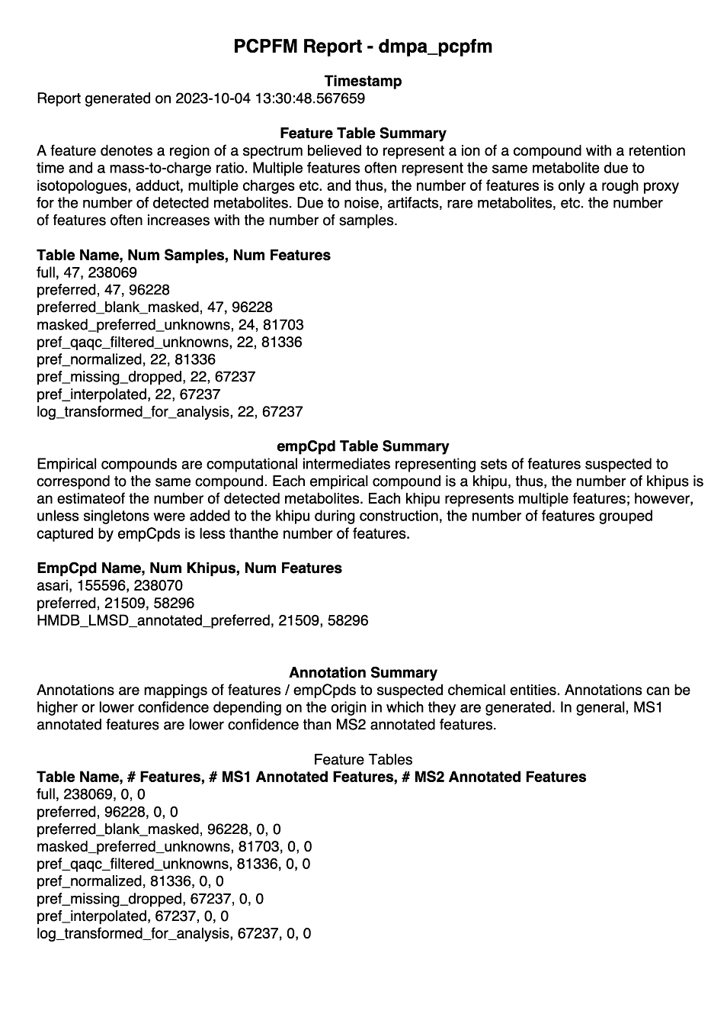
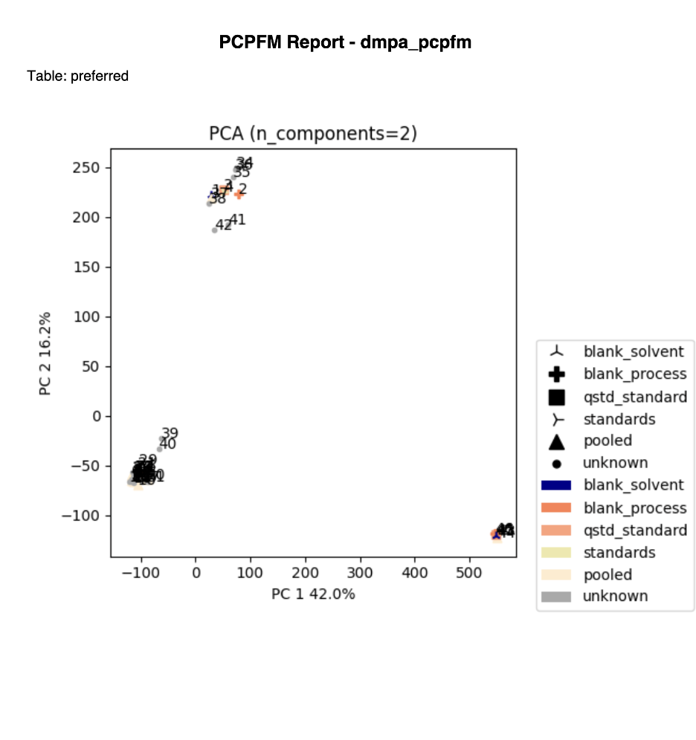
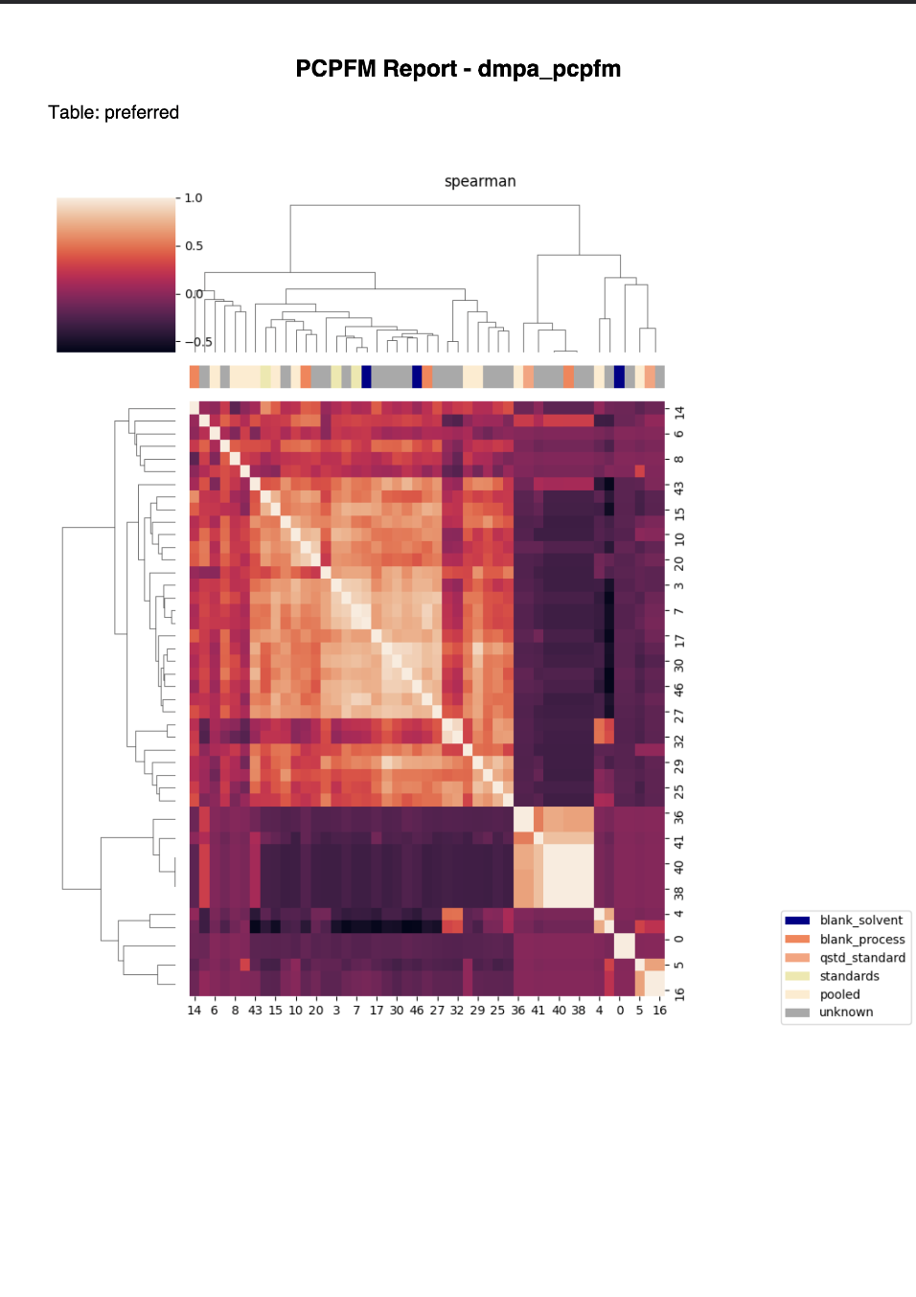
Example Reports

Slide 39
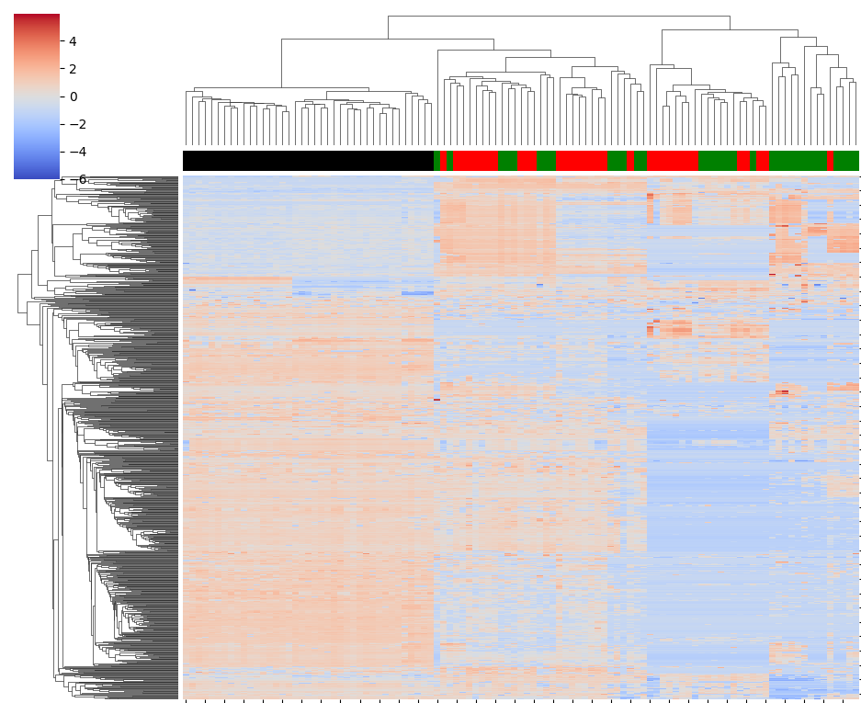
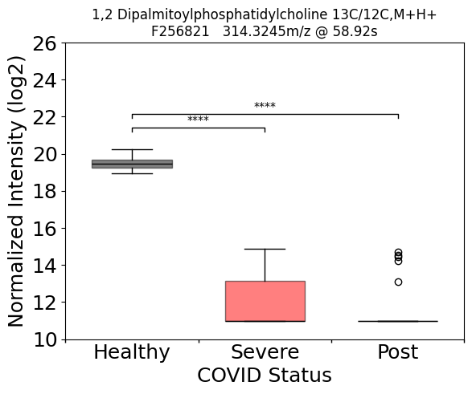
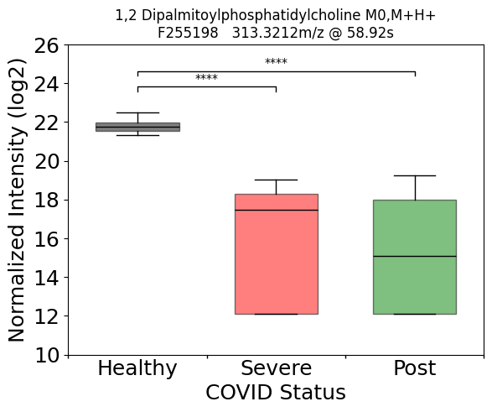
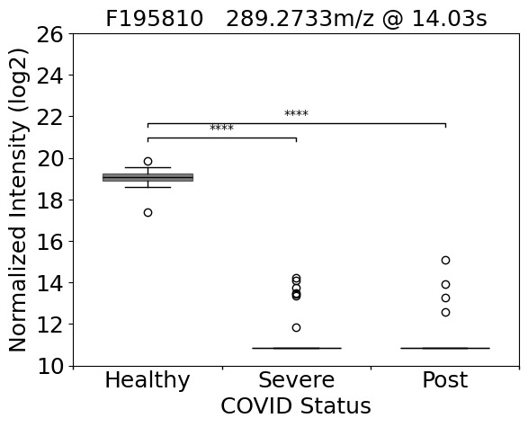
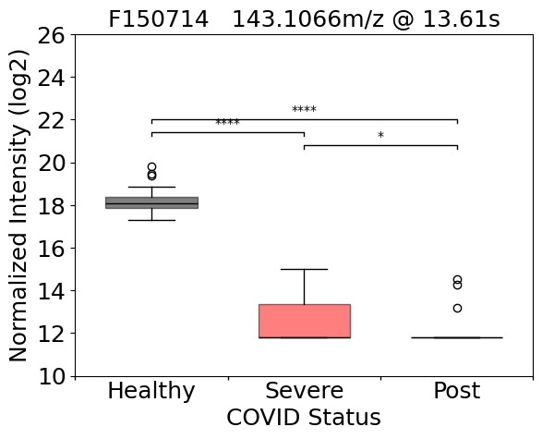
Example pcpfm Results
Ansone 2021 re-analysis
1,2-DPPC [H+, m+¹³C₁]
F210226
314.3245m/z @ 58.78
1,2-DPPC [H+, m]
F209589
313.3212m/z @ 58.92s
4
0
26
Z-Score
26
-4
-4
22
22
18
18
14
14
10
10
HC
SC19
HC
PC19
SC19
PC19
Normalized Log2 Abundances
F150714
143.1066m/z @ 13.61s
F195810
289.2733m/z @ 14.03s
26
26
22
22
18
18
Significant Features (p_{corr} < .05)
14
14
10
10
HC
SC19
PC19
HC
SC19
Healthy Control (HC)
Severe COVID-19 (SC19)
Post COVID-19 (PC19)
COVID Status
PC19
* p_{corr} <.05
** p_{corr} <.01
*** p_{corr} <.001
**** p_{corr} <.0001
Pcpfm recapitulates the clustering of patients from the original manuscript
But produces different annotations.
Ansone, L., et al., Amino Acid Metabolism is Significantly Altered at the Time of Admission in Hospital for Severe COVID-19 Patients: Findings from Longitudinal Targeted Metabolomics Analysis. Microbiol Spectr, 2021. 9(3): p. e0033821.

Slide 40
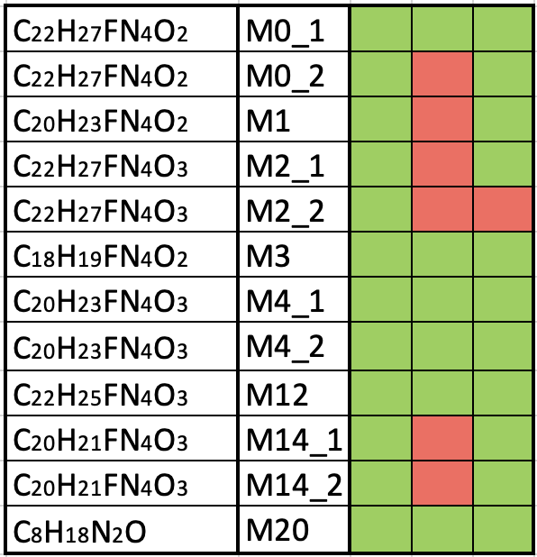
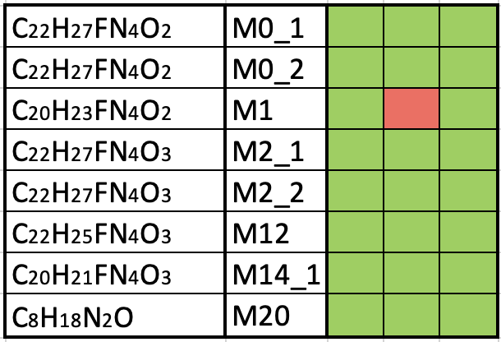
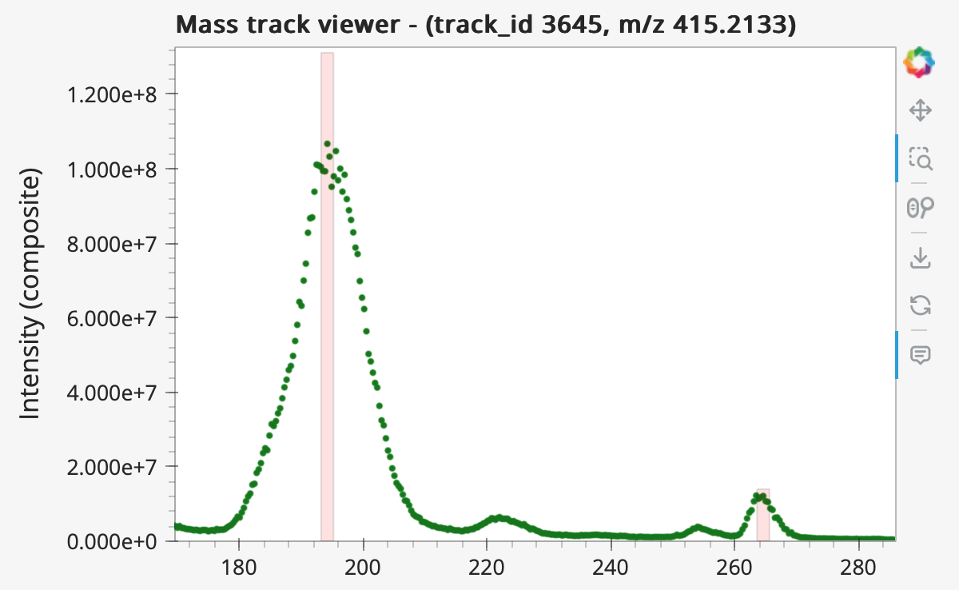
Example pcpfm Results
Bowen 2023 re-analysis
Full
Preferred
Bowen
Full
Preferred
Formula
ID
Bowen
Cell Pellet
x10⁸
Formula
ID
Cell Pellet, m/z = 415.2133
Media
1.2
Not Detected
1.0
Detected
0.8
Composite Mass Track
Intensity (absolute)
0.6
0.4
M2_2
0.2
0
280
260
200
240
Not Detected
180
220
Detected
Pcpfm finds most features without a specialized workflow
Trivial inspection of missing features
Bowen, T.J., et al., Simultaneously discovering the fate and biochemical effects of pharmaceuticals through untargeted metabolomics. Nat Commun, 2023. 14(1): p. 4653.

Slide 41
Advanced pcpfm Hands-On

Slide 42
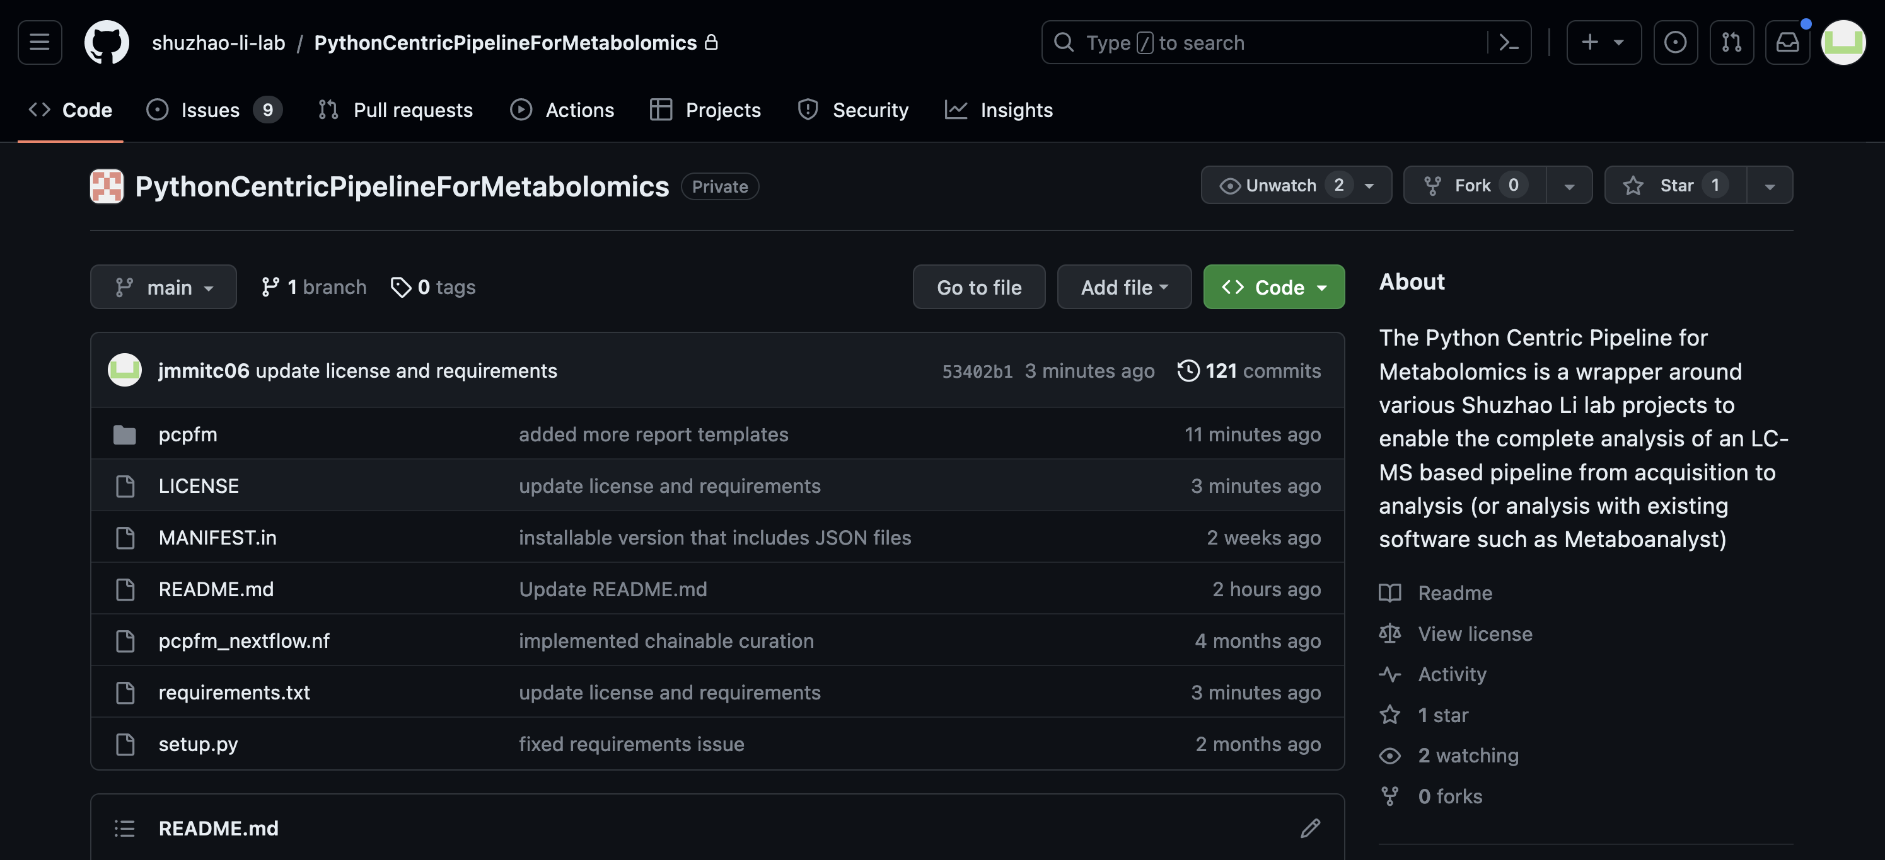
Open Source Matters
Both Asari and pipeline are open-source
Reuse welcome
Feel free to submit issues and request features

Slide 43
Conclusions
Still looking for feedback, evolving but stable enough.
Data analysis notebooks in the repository.
https://github.com/shuzhao-li-lab/PythonCentricPipelineForMetabolomics
Link to other tutorials and examples.
https://github.com/shuzhao-li-lab/pcpfm_tutorials (work in progress)
Data repo for datasets
https://github.com/shuzhao-li-lab/data/
Contact me at: joshua.mitchell@jax.org
Notes:
Will push new version to pypi with new name before conference.

Slide 44
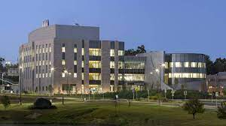
Acknowledgements
Shuzhao Li Group
Shuzhao Li
Yuanye Chi
Shujian Cheng
Maheshwor Thapa
Minghao Gong
Amnah Siddiqa (Former)
Other JAX Collaborators
Robson Lab
Juliana Alcoforado Diniz
Zukai Liu
Arti Taggar
Dylan Baker
Anahita Amiri
Non-Jax Collaborators
Stephen Barnes
Landon Wilson
Jianguo (Jeff) Xia
Lei Xu
The Jackson Laboratory for Genomic Medicine
Farmington, CT
Funding
UM1HG012651
RO1AI149746
U01CA235493

Slide 45
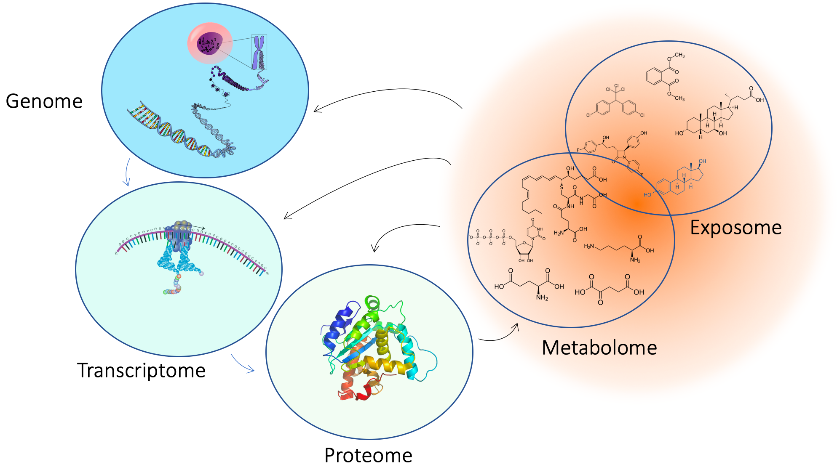
Metabolomics is the comprehensive measurement of biological chemical space
Gene Space
Chemical Space
Notes:
Metabolomics is the comprehensive measurement of biological chemical space. This includes the small molecules present in tissues and cells of organisms, many of which are endogenous metabolites while others are from the environment (i.e., the metabolome and exposome). In this figure, we see where metabolomics and exposomics fits in the central dogma of biology. Genes are expressed to yield transcripts, that are translated to yield proteins which in turn perform the chemical reactions that produce many of the metabolites observed in oru experiments. These metabolites also greatly impact the activity of the genome, transcriptome, and proteome.

Slide 46
Metabolomics is the comprehensive measurement of biological chemical space
Gene Space
Chemical Space
SEQUENCING
MASS SPECTROMETRY
Notes:
Another notable distinction is the technologies used for studying these entities. On the left, sequencing of one form or another is used to analyze these samples. Chemical space on the other hand is measured primarily using mass spectrometry-based techniques.

Slide 47
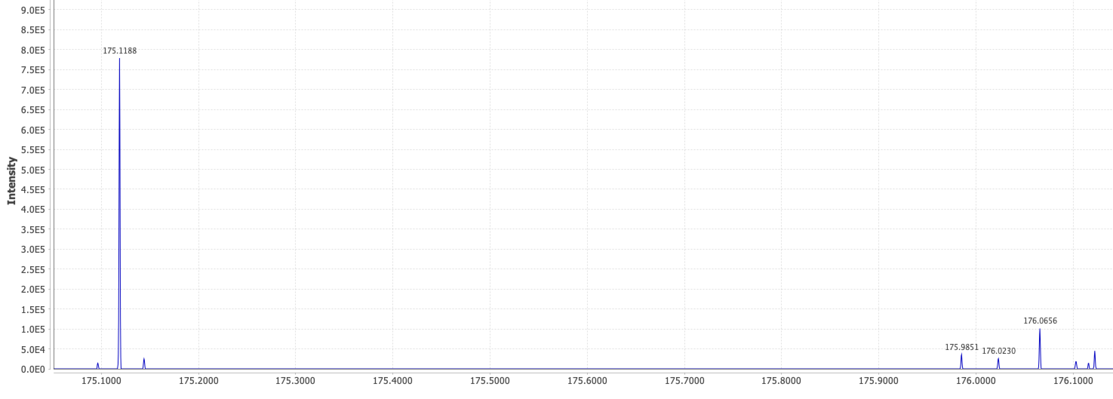
Advantages and challenges of Mass Spectrometry
A single mass spectrum (i.e., scan) of a complex mixture is a lot of data.
m, [+H⁺]
Arginine
Each scan is a composition of spectra for many compounds, including different adducted forms, isotopologues, etc.
C₆H₁₄N₄O₂
175.1188 ≈ 174.1114 + 1.0078
m+¹³C₁, [+H⁺]
Notes:
Another notable distinction is the technologies used for studying these entities. On the left, sequencing of one form or another is used to analyze these samples. Chemical space on the other hand is measured primarily using mass spectrometry-based techniques.

Slide 48
Advantages and challenges of Mass Spectrometry
Chromatographic Retention Time
Additionally, most experiments couple chromatography to mass spectrometry meaning multiple spectra for each sample. Data becomes complex quickly.
Notes:
Another notable distinction is the technologies used for studying these entities. On the left, sequencing of one form or another is used to analyze these samples. Chemical space on the other hand is measured primarily using mass spectrometry-based techniques.

